Slide 1
New Regs update
Health and Safety at Work Act 2015:
Plant, structures and working at heights
Dave Moore. Manager Health and Safety by Design
CCG. Safety in Design – Practice Forum. Dec 2nd 2021

Slide 2
Today
State of play
Main areas that are changing
Where to learn more
Upstream
Where things are going in 2022-23

Slide 3
State of play
  Exposure draft now likely to be released towards the middle of 2022
  No formal opportunities to comment before that draft is available
  If new to this, check the first consultation draft (July 2019) and submissions, to get an idea
  About 5-6 months behind at the moment
  Talk of a Oct 2022 launch but …
Notes:
Looks like Ian Smith old keeper

Slide 4
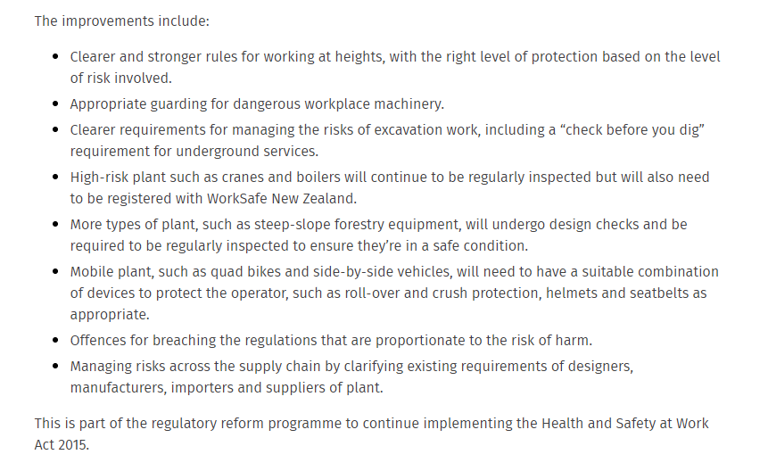
Changes

Slide 5
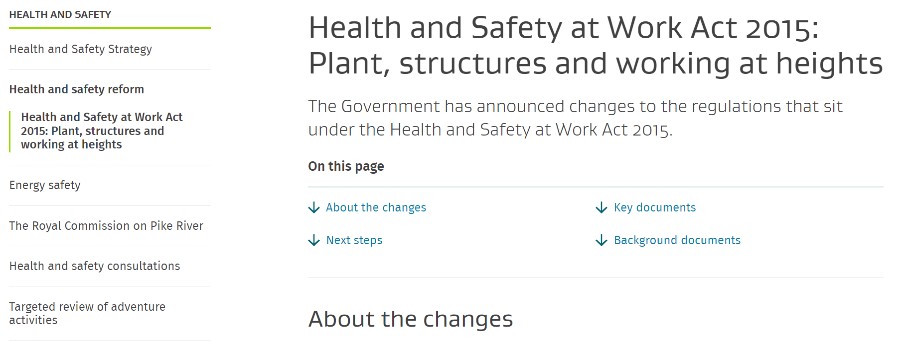
Health and Safety at Work Act 2015: Plant, structures and working at heights | Ministry of Business, Innovation & Employment (mbie.govt.nz)

Slide 6
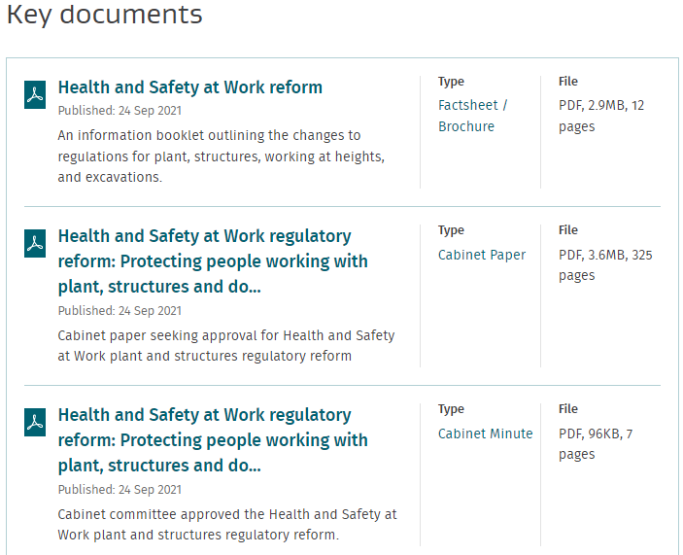
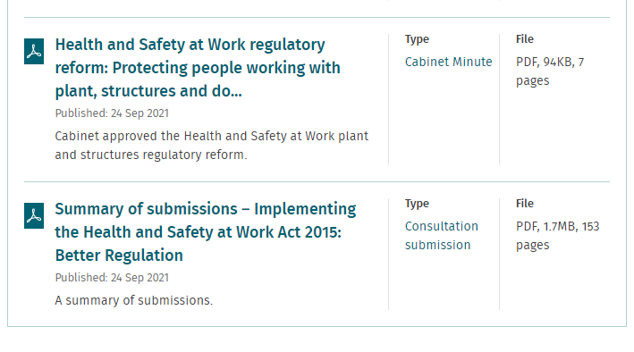

Slide 7
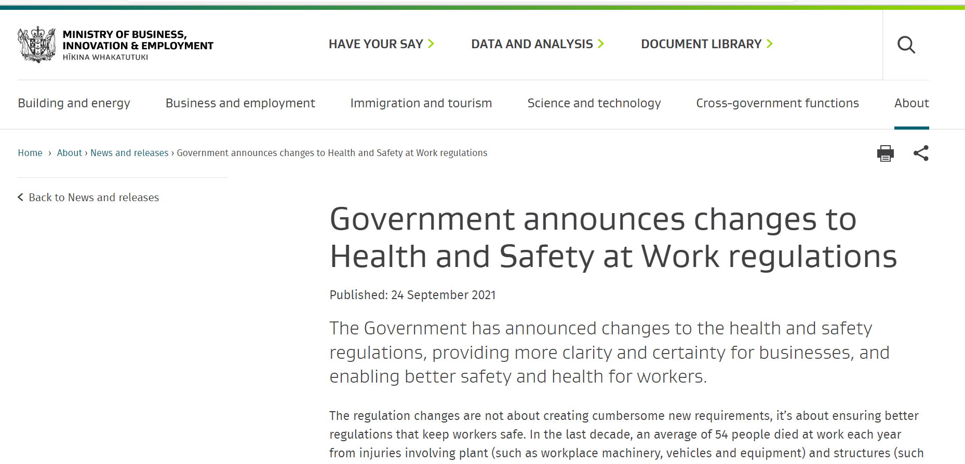
Government announces changes to Health and Safety at Work regulations | Ministry of Business, Innovation & Employment (mbie.govt.nz)

Slide 8
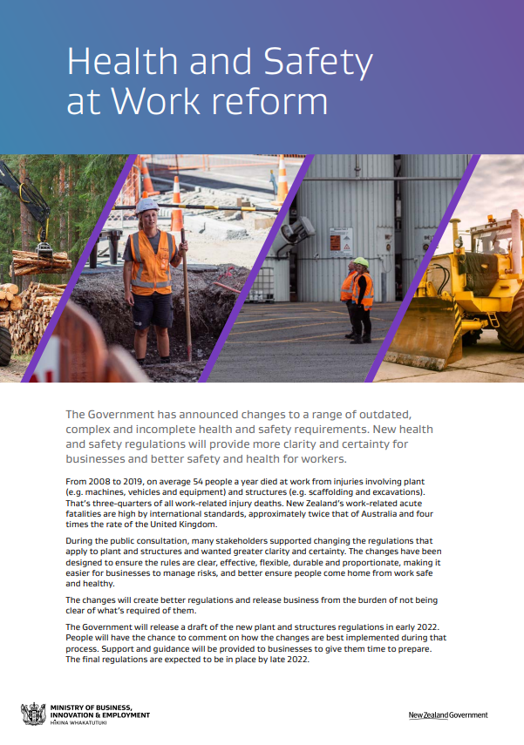


Slide 9
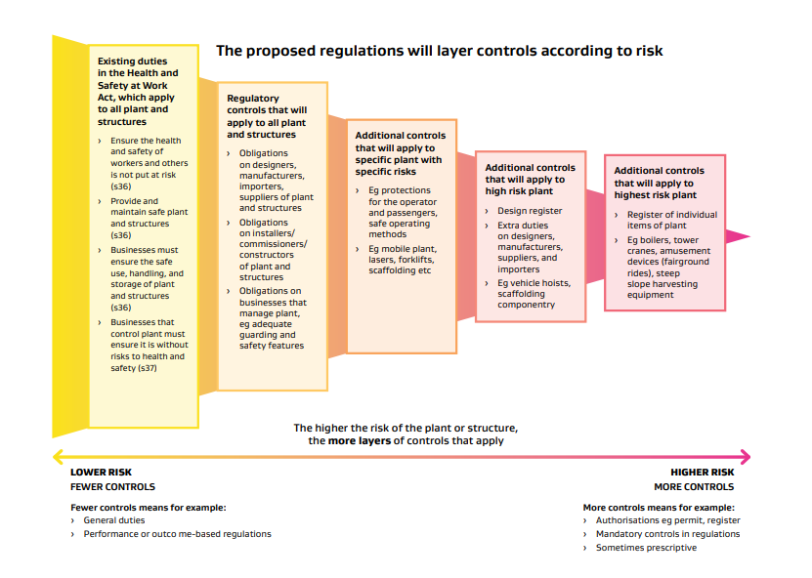
Notes:
Major changes are probably for people with high risk plant

Slide 10
Upstream

Slide 11
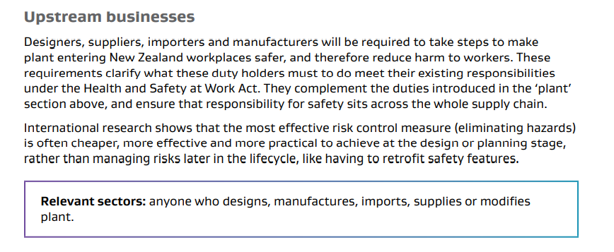
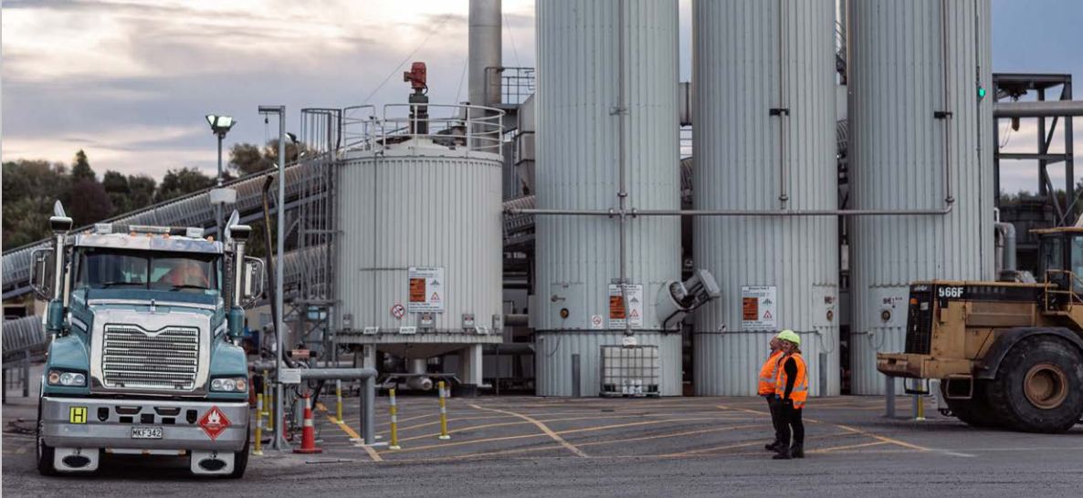

Slide 12
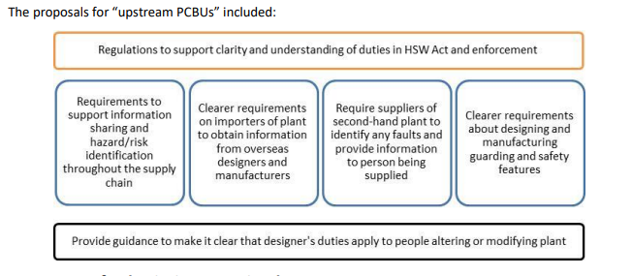

Slide 13
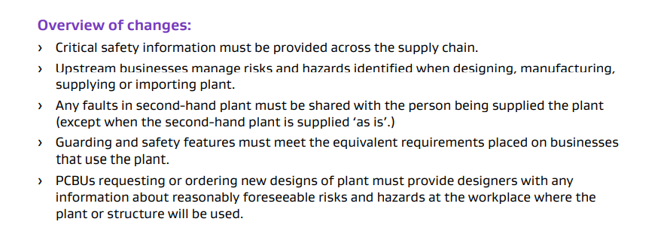
Notes:
Foreseeable misuse

Slide 14
2022-23

Slide 15
Evidence cycle flows for SiD/HSbD
  An area of focus in 2022-23 across agencies
  Picking up recurrent failure scenarios in our work
  Identifying key elements in these scenarios
  Going to the source of latent failure (not always further up the supply chain)
  System integration design draws on many Upstreams
  Rebalancing responsibilities across the system
  Today’s Best Practice = tomorrow’s Regulation?
Notes:
Current discussions
An area of focus in 2022-23 across agencies. Cross Govt HFE Group. MBIE/WorkSafe overlapping jurisdictions.
Picking up recurrent failure scenarios in our work. ACC data. Social media scans. Intelligence building across agencies.
Identifying key elements in these scenarios . Elements in the design tools / work / environment (physical and psychosocial)
Going to the source (not always further up the supply chain). Where the power is normally. Can be a monopoly holder. Client or Commissioner of major work. Considers externalities.
System integration draws on many upstreams. Military ensembles. Buildings. HSBD is a dynamic process that includes upstream responsibilities being met – but not relied on. Trialing. Simulation.
Rebalancing responsibilities across the system. For more equitable and effective outcomes for all in the system.
Today’s Good Practice is tomorrows Regulation. Industry innovators can influence by demonstrating what is reasonable and achievable. Do more than having your shout – show what works.

